Slide 1
First presentation
Marcel Siwiela

Slide 2
Objective of the project
Reading data from several sensors:
Temperature and humidity – DHT11
Light intensity – BH1750
Pressure – BMP280
Data transfer of measured values in the following order:
NUCLEO-G071RB -> ESP8266 ---(WiFi)---> ESP8266 ->
-> NUCLEO-L476RG -> DISPLAY

Slide 3
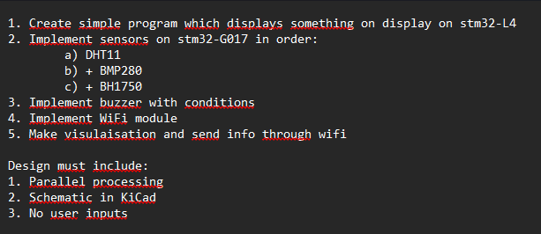
Specifications

Slide 4
A description of hardware
NUCLEO-G071RB
ESP8266 x2 (WiFi)
NUCLEO-L476RG
Waveshare 4inch TFT Touch Shield
Temperature and humidity – DHT11
Light intensity x2 – BH1750
Pressure – BMP280
Wires, breadboard

Slide 5
Planned final result of the project.
Displaying sensor values on a screen using data transmission via Wi-Fi modules

